Slide 1
IST718 A Statistical Perspective on Learning
Willard Williamson
Adjunct Professor
iSchool, Syracuse University
linkedin.com/in/ncc-1701-d

Slide 2
Attendance
Please fill out the attendance sheet: https://docs.google.com/spreadsheets/d/1G5tiqXQn9mwyubWdINtPI_QONXH1_2U8oYikksgWlss/edit?usp=sharing
Write in a ‘1’ if you are present

Slide 3
Outline of this unit
Definition of statistical learning
Terminology
Function learning
Prediction: Reducible vs irreducible error
Inference
Parametric models vs non-parametric models
Supervised vs unsupervised learning
Regression vs classification
Interpretability vs flexibility

Slide 4
What is Statistical Learning?
From ISLR:
“Statistical learning refers to a vast set of tools for understanding data. These tools can be classified as supervised or unsupervised.”
Statistical learning refers to a set of tools for modeling and understanding complex datasets.
Statistical learning refers to a set of approaches for estimating f.

Slide 5
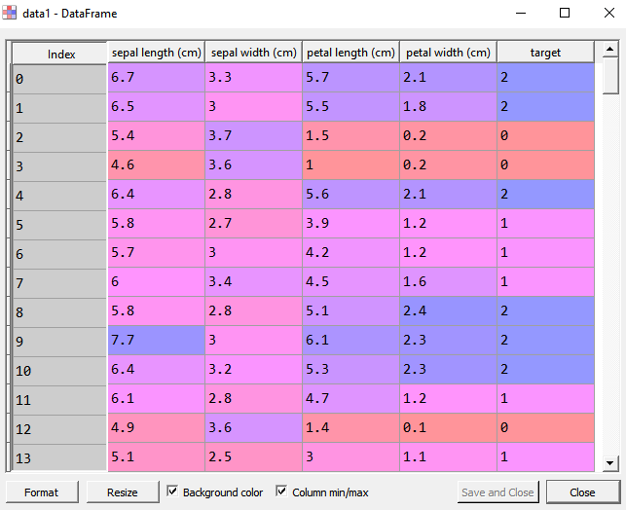
Terminology
Features: Input variables, predictors, or independent variables
In the data frame to the right: Sepal length, sepal width, petal length, petal width.
Target: What we want to predict or associate with what we measure: AKA outputs, response, dependent variable
In the data frame to the right: target

Slide 6
Terminology: Supervised Learning
Supervised statistical learning involves building a statistical model for predicting, or estimating, an output based on one or more inputs.
Example supervised ML Algorithms:
Linear & Logistic Regression
Decision Trees
Deep Learning
Support Vector Machine
We will focus on supervised learning first

Slide 7
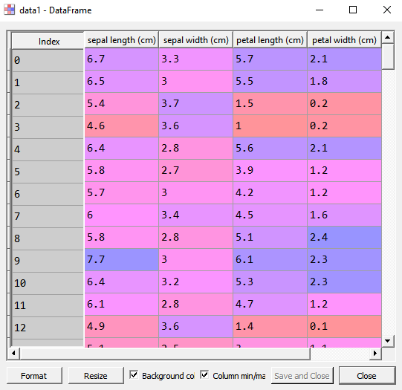
Terminology: Unsupervised Learning
With unsupervised statistical learning, there are inputs but no supervising output; nevertheless, we can learn relationships and structure from such data.
Example ML Algorithms
Hierarchical Clustering
K-Means
Mixture Models
Self Organizing Maps
Autoencoders

Slide 8
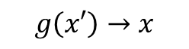
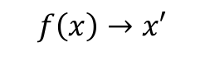
What is unsupervised learning
A learning a function that maps the input into an intermediate representation
That intermediate representation makes the data easier to interpret
There should be a map back from such intermediate representation into original space
The map from intermediate to feature space (g) should be as close as possible to the original input
Feature space
X
Intermediate space
X’
Feature space
X
$$f\left(x\right)→x′$$
$$g\left(x′\right)→x$$
x
x'
x

Slide 9
Examples of unsupervised learning
Clustering: Cluster the diabetic patients into groups
Example: K-Means
Topic modeling: Describe the content of a set of documents (e.g., tweets) based on topics (soft clustering)
Dimensionality reduction: Transform a large set of features into a smaller set of features while retaining the variability of the data
Example Dimensionality Reduction: Principal Component Analyses (PCA)
Feature space
X
Intermediate space
X’
Feature space
X
$$f\left(x\right)→x′$$
$$g\left(x′\right)→x$$
x
x'
x

Slide 10
Summary: Supervised vs unsupervised learning
Supervised (See terminology in previous slides):
Each X (observation) is associated with a Y (target)
Unsupervised (See terminology in previous slides):
We have X but no Y (target)
Supervised learning is in general easier because we know how well we are building the association
Unsupervised learning is harder because there is no clear evaluation method.
This course will mostly deal with supervised learning.

Slide 11
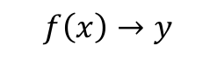
Mathematical formalization of learning
We will say that we want to learn a function f about a phenomenon
A function takes one element x that belongs to the feature space X and maps it into one and only one element y in the output space Y
Feature space
X
Output space
Y
$$f\left(x\right)→y$$
f(x)
x
y₁
y₂
x

Slide 12
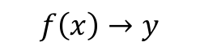
Mathematical formalization of learning
Predict whether a patient, hospitalized due to a heart attack, will have a second heart attack. The prediction is to be based on demographic, diet and clinical measurements for that patient.
Feature space
X
Output space
Y
x:
?
$$f\left(x\right)→y$$
y:
?
x
y
X:
?
Y:
?

Slide 13
Mathematical formalization of learning
Predict whether a patient, hospitalized due to a heart attack, will have a second heart attack. The prediction is to be based on demographic, diet and clinical measurements for that patient.
Feature space
X
Output space
Y
x:
Specific instances of demographics, diet, clinical measure of a patient hospitalized due to a heart attack
$$f\left(x\right)→y$$
y:
Whether specific patient will have a second heart attack
x
Y=True
X:
Space of all instances of demographics, diet, and clinical data of patients hospitalized for heart attack
Y=False
Y:
True or False

Slide 14
Example: Diabetes dataset
Ten baseline variables including age, sex, body mass index, average blood pressure, and six blood serum measurements were obtained for each of n = 442 diabetes patients, as well as the response of interest, a quantitative measure of disease progression one year after baseline
What might we want to “learn” from this dataset?

Slide 15
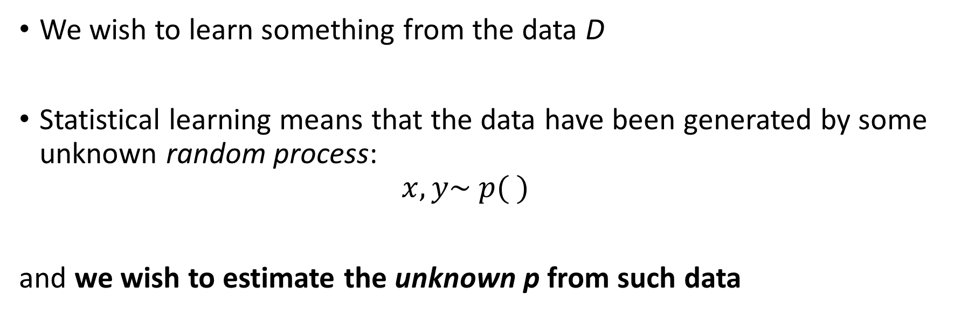
A statistical perspective on learning
We wish to learn something from the data D
Statistical learning means that the data have been generated by some unknown random process: $x,y\sim p( )$
and we wish to estimate the unknown p from such data
This reads x and y follow the probability distribution described by p.

Slide 16
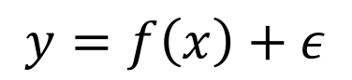
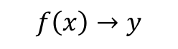
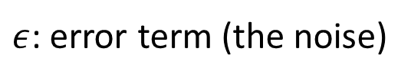
A statistical perspective on learning
Statistical learning refers to a set of approaches for estimating f assuming that noise is added into the system and that the noise cannot be predicted from x
Feature space
X
Added noise
Output space
Y
$$y=f\left(x\right)+ε$$
$ε$: error term (the noise)
x
y
$$f\left(x\right)→y$$

Slide 17
Why we estimate f:
Prediction
Inference

Slide 18
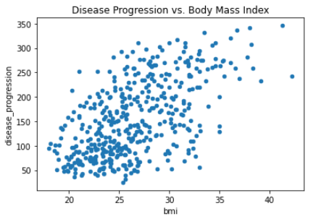
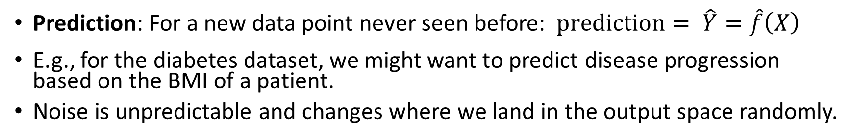
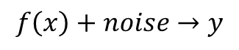
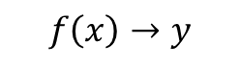
Why we estimate f: Prediction
Prediction: For a new data point never seen before: $prediction= \hat{Y}=\hat{f}\left(X\right)$
E.g., for the diabetes dataset, we might want to predict disease progression based on the BMI of a patient.
Noise is unpredictable and changes where we land in the output space randomly.
Feature space
X
Output space
Y
$$f\left(x\right)+noise→y$$
x
y
$$f\left(x\right)→y$$
Notes:
Show that there might be multiple f for the same data and we have to pick one according to a criteria. Using a Guassian assumption and MLE, for example, we might choose the squared error as a goal.

Slide 19
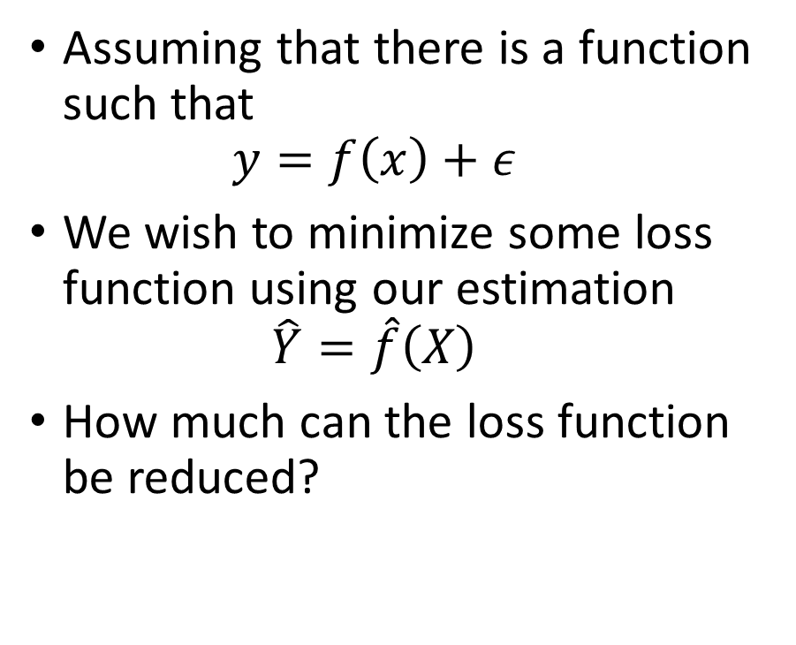
Why we estimate f: Prediction
Assuming that there is a function such that $y=f\left(x\right)+ε$
We wish to minimize some loss function using our estimation $\hat{Y}=\hat{f}\left(X\right)$
How much can the loss function be reduced?
Notes:
Show that their might be multiple f for the same data and we have to pick one according to a criteria. Using a Guassian assumption and MLE, for example, we might choose the squared error as a goal.

Slide 20
Squared Error
The diagonal line represents the best estimate of the cloud of data points.
The best estimate is the line that minimizes the sum of the errors.
One error is shown as the vertical line.
The error is the distance between the diagonal line and the real data point.

Slide 21
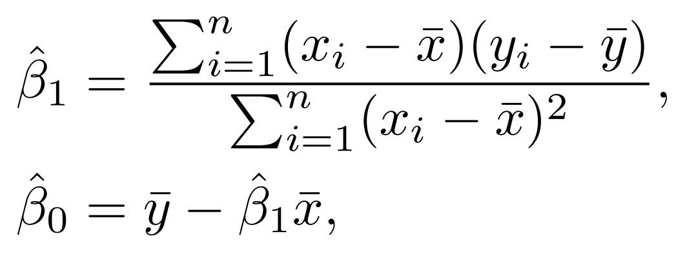
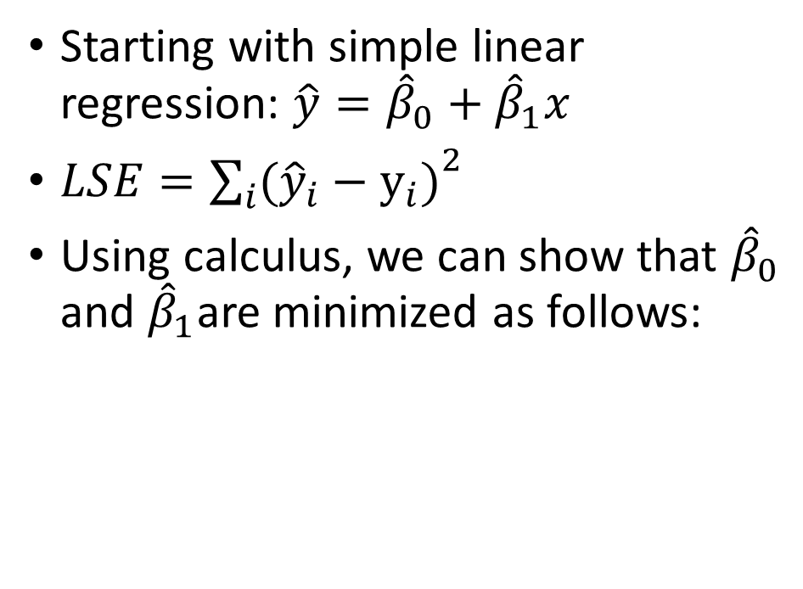
Least Square Error Loss Function (LSE)
Starting with simple linear regression: $\hat{y}={\hat{β}}_{0}+$ ${\hat{β}}_{1}x$
${LSE=\sum_{i}{({\hat{y}}_{i}−y_{i})}}^{2}$
Using calculus, we can show that ${\hat{β}}_{0}$ and ${\hat{β}}_{1}$are minimized as follows:

Slide 22
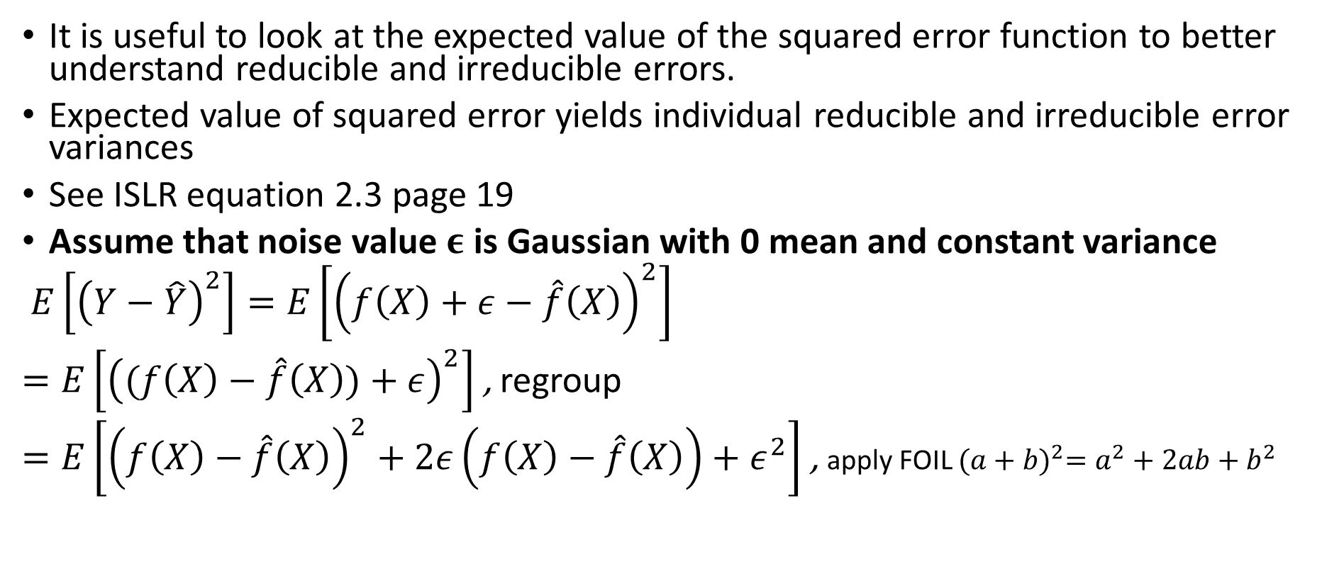
Expected Value of Squared Error
It is useful to look at the expected value of the squared error function to better understand reducible and irreducible errors.
Expected value of squared error yields individual reducible and irreducible error variances
See ISLR equation 2.3 page 19
Assume that noise value $ε$ is Gaussian with 0 mean and constant variance
$E\left[{\left(Y−\hat{Y}\right)}^{2}\right]=E\left[{\left(f\left(X\right)+ε−\hat{f}\left(X\right)\right)}^{2}\right]$
$=E\left[{\left((f\left(X\right)−\hat{f}\left(X\right))+ε\right)}^{2}\right]$ , regroup
$=E\left[{\left(f\left(X\right)−\hat{f}\left(X\right)\right)}^{2}+2ε\left(f\left(X\right)−\hat{f}\left(X\right)\right)+ε^{2}\right]$ , apply FOIL ${(a+b)}^{2}=a^{2}+2ab+b^{2}$

Slide 23
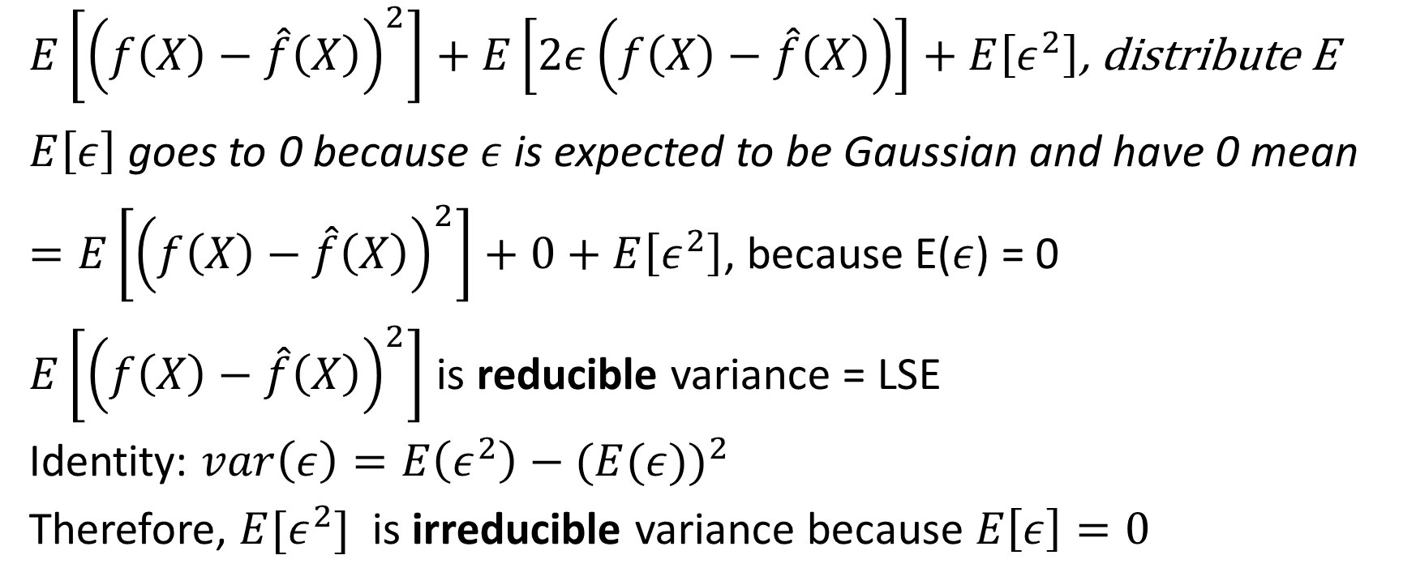
Expected Value of Squared Error
$E\left[{\left(f\left(X\right)−\hat{f}\left(X\right)\right)}^{2}\right]+E\left[2ε\left(f\left(X\right)−\hat{f}\left(X\right)\right)\right]+E\left[ε^{2}\right]$, distribute E
$E\left[ε\right]$ goes to 0 because $ε$ is expected to be Gaussian and have 0 mean
$=E\left[{\left(f\left(X\right)−\hat{f}\left(X\right)\right)}^{2}\right]+0+E\left[ε^{2}\right]$, because E($ε$) = 0
$E\left[{\left(f\left(X\right)−\hat{f}\left(X\right)\right)}^{2}\right]$ is reducible variance = LSE
Identity: $var\left(ε\right)=E\left(ε^{2}\right)−{(E(ε))}^{2}$
Therefore, $E[ε^{2}]$ is irreducible variance because $E\left[ε\right]=0$

Slide 24
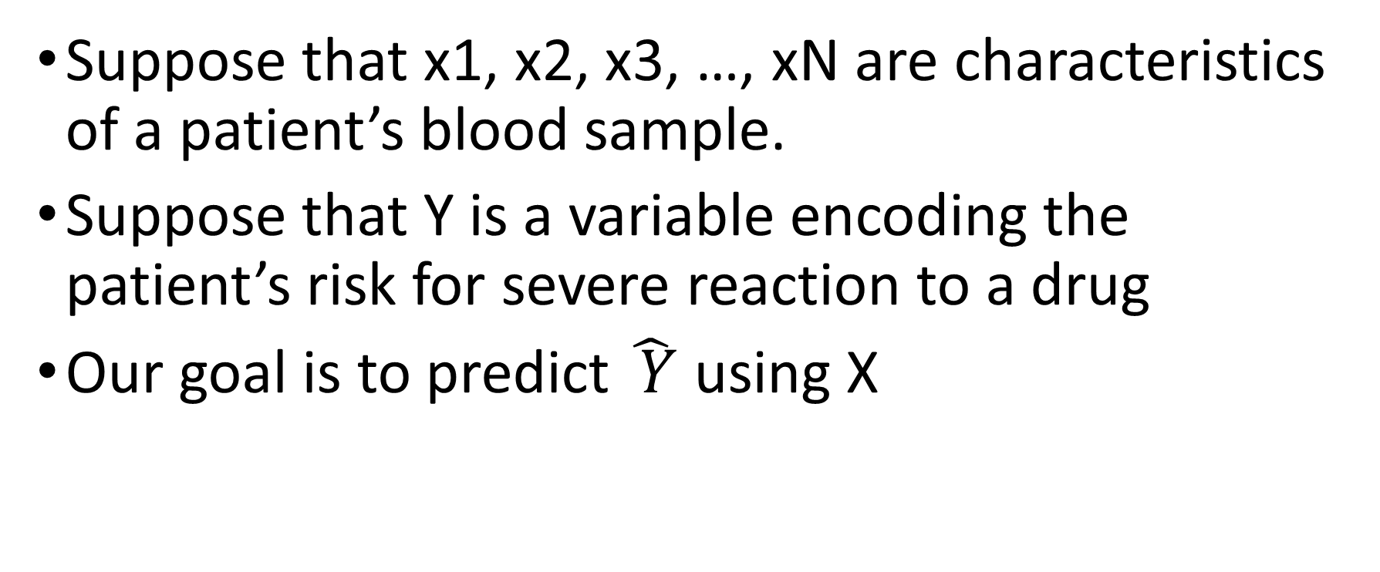
What is Reducible and Irreducible Error
Suppose that x1, x2, x3, …, xN are characteristics of a patient’s blood sample.
Suppose that Y is a variable encoding the patient’s risk for severe reaction to a drug
Our goal is to predict $\hat{ Y}$ using X

Slide 25
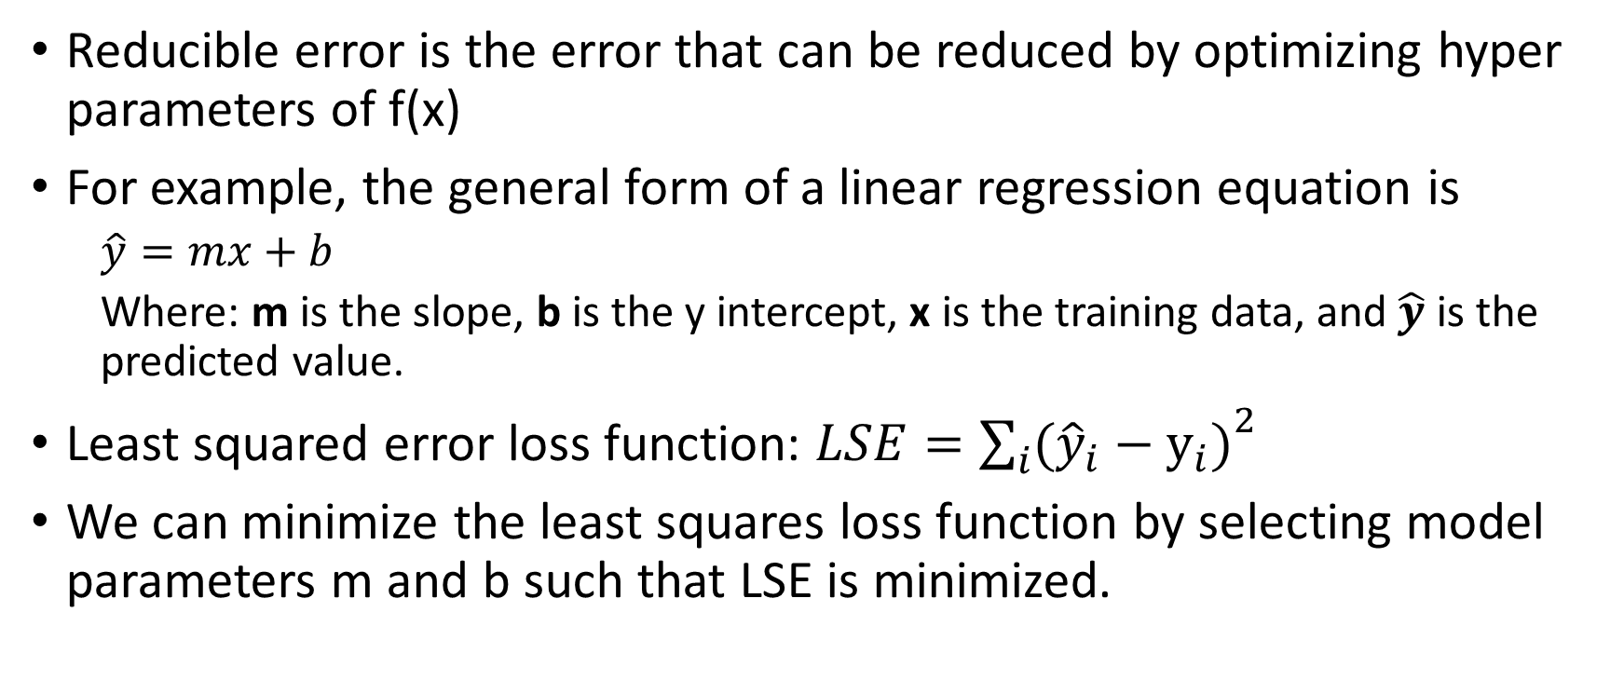
What is Reducible Error
Reducible error is the error that can be reduced by optimizing hyper parameters of f(x)
For example, the general form of a linear regression equation is
$\hat{y}=mx+b$
Where: m is the slope, b is the y intercept, x is the training data, and $\hat{y}$ is the predicted value.
Least squared error loss function: ${LSE=\sum_{i}{({\hat{y}}_{i}−y_{i})}}^{2}$
We can minimize the least squares loss function by selecting model parameters m and b such that LSE is minimized.

Slide 26
What is Irreducible Error?
The irreducible error ‘epsilon’ in the diabetes data set example could be due to:
The patient’s general health on a given day
Small manufacturing variations in the drug
Small measurement errors in x1, x2, x3, …, xN

Slide 27
Why we estimate f: Inference
Inference: Sometimes we want to understand f (look inside f)
Which predictors are important in the process of predicting Y: e.g., do we need to include gender in the prediction of blood pressure?
Relationship between Y and each X: e.g., blood pressure is higher for older people?
Is the relationship between Y and X appropriately captured by the model? Is the linear relationship enough?
See ISLR page 19

Slide 28
How do we estimate f?
We estimate using training data.
For notation, we will assume that we have n observations where each observation is a row in the data set.
x_{ij} is a specific row / column value in the data set: ‘i’ is the row and j is the column.
y_{i} is the dependent variable / target / class for a specific observation.
Two main methods for estimating F
Parametric Methods
Non Parametric Methods

Slide 29
How do we estimate f: Parametric Methods
Makes an assumption about the shape of f
For example, assume the form of f is a linear model
Use a procedure to fit or train the model and reduce the loss function for the model

Slide 30
How do we estimate f: Nonparametric Methods
Nonparametric methods don’t make assumptions about f.
Example: Non parametric means that the model does not impose a specific function like linear regression (which assumes that y = mx + b)
Informally, they try to get as close as possible to the training data but not too close.
In general, the more data, the better the fit, but the harder to interpret.
Example Non Parametric Method:
Random Forest

Slide 31
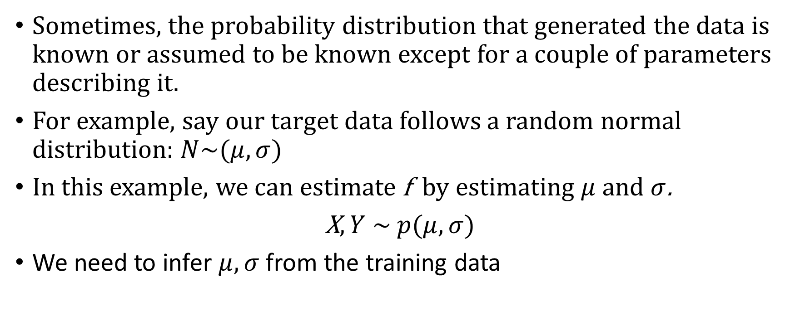
How we estimate f
Sometimes, the probability distribution that generated the data is known or assumed to be known except for a couple of parameters describing it.
For example, say our target data follows a random normal distribution: $N\sim (μ,σ)$
In this example, we can estimate f by estimating $μ$ and $σ$.
X$,Y \sim p(μ,σ)$
We need to infer $μ,σ$ from the training data

Slide 32
Maximum Likelihood Estimation (MLE)
Estimate the probability distribution parameters that are most likely to best represent the data.
For example, if data follows the normal distribution, estimate the mean and standard deviation of the normal distribution that produces a distribution that is the closest match to the data.

Slide 33
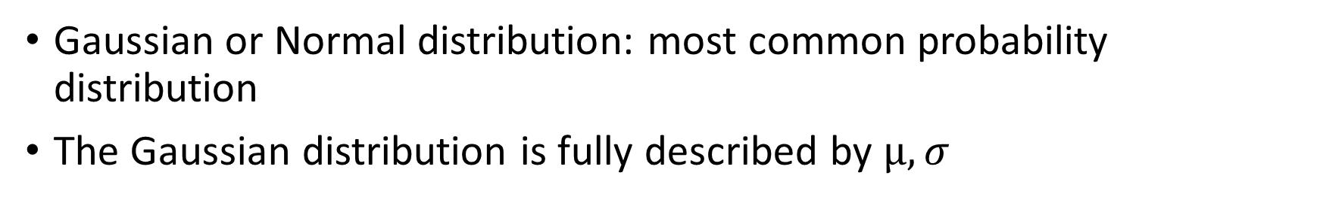
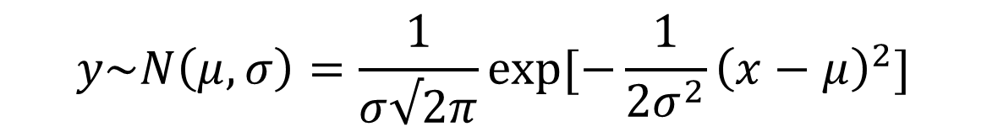
Gaussian distribution
Gaussian or Normal distribution: most common probability distribution
The Gaussian distribution is fully described by $μ,σ$
$$y\sim N\left(μ,σ\right)=\frac{1}{σ√2π}\exp{[−\frac{1}{2σ^{2}}{\left(x−μ\right)}^{2}]}$$
Notes:
Mu controls the position and sigma controls the spread.

Slide 34
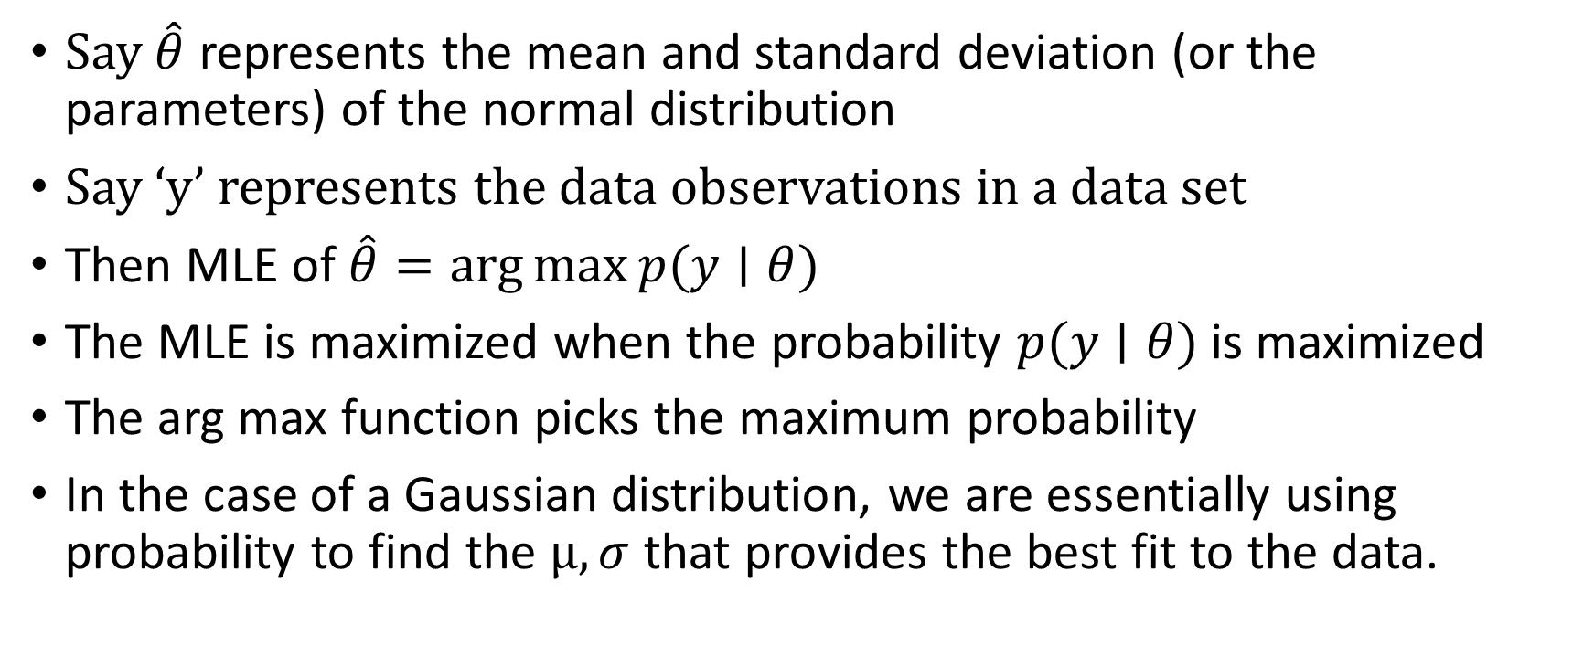
Maximum Likelihood Estimation (MLE)
Say $\hat{θ}$ represents the mean and standard deviation (or the parameters) of the normal distribution
Say ‘y’ represents the data observations in a data set
Then MLE of $\hat{θ}=\arg{\max{p(y∣θ)}}$
The MLE is maximized when the probability $p(y∣θ)$ is maximized
The arg max function picks the maximum probability
In the case of a Gaussian distribution, we are essentially using probability to find the $μ,σ$ that provides the best fit to the data.

Slide 35
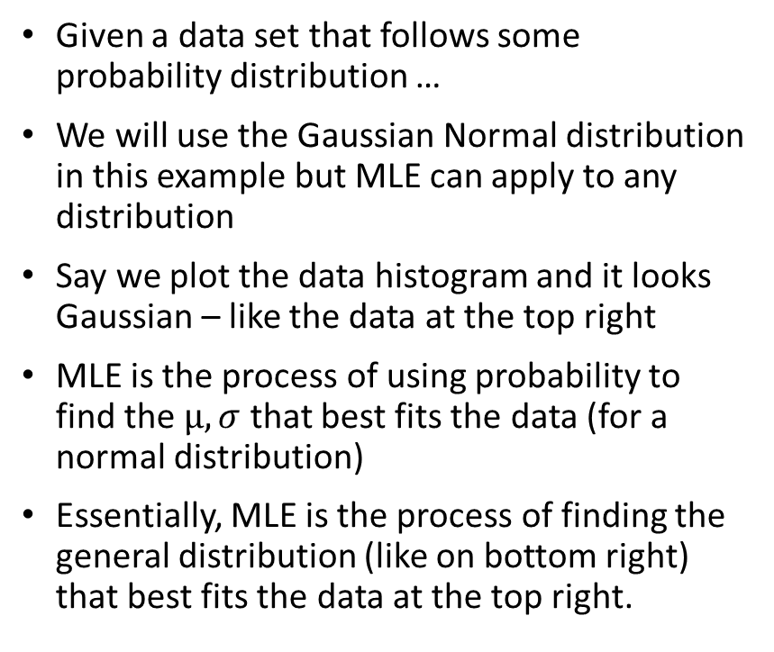
A high-level description of MLE
Given a data set that follows some probability distribution …
We will use the Gaussian Normal distribution in this example but MLE can apply to any distribution
Say we plot the data histogram and it looks Gaussian – like the data at the top right
MLE is the process of using probability to find the $μ,σ$ that best fits the data (for a normal distribution)
Essentially, MLE is the process of finding the general distribution (like on bottom right) that best fits the data at the top right.

Slide 36
Derivation of Least Squares Using MLE
The ISLR textbook says: “In the linear regression setting, the least squares approach is in fact a special case of maximum likelihood” (page 133).
The following slides show how to use MLE to derive the least squares equation.
Uses information from the following stack exchange URL: https://stats.stackexchange.com/questions/253345/relationship-between-mle-and-least-squares-in-case-of-linear-regression

Slide 37
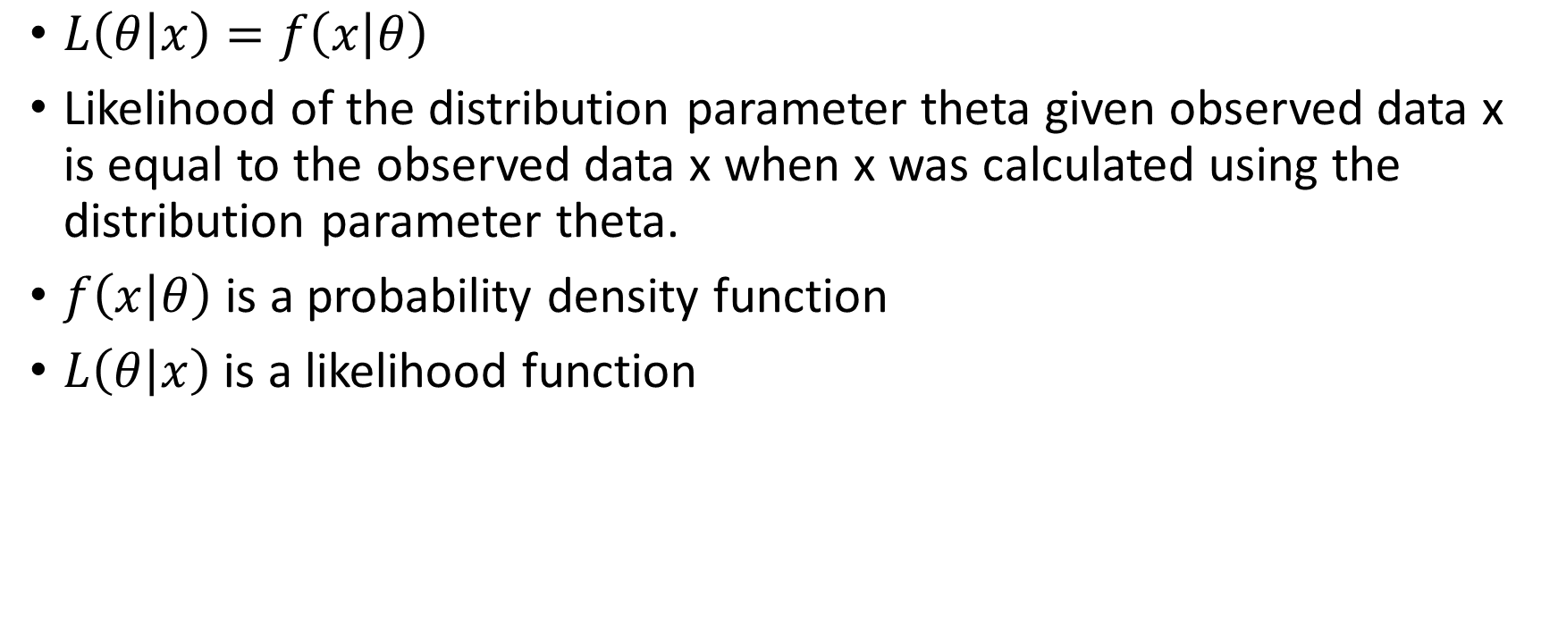
Likelihood Function
$L\left(θ | x\right)=f\left(x | θ\right)$
Likelihood of the distribution parameter theta given observed data x is equal to the observed data x when x was calculated using the distribution parameter theta.
$f\left(x | θ\right)$ is a probability density function
$L\left(θ | x\right)$ is a likelihood function

Slide 38
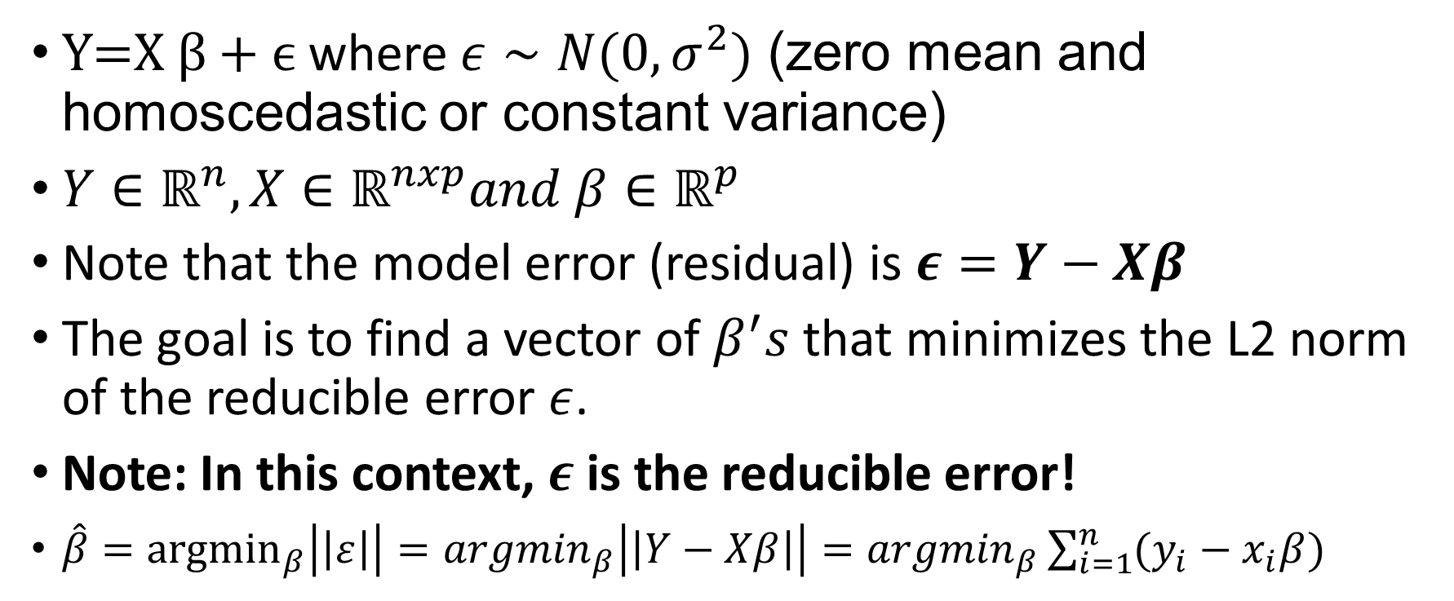
Derivation of Least Squares Using MLE
$\text{Y}\text{=}\text{X} β\text{ + }ϵ$ where $ε∼N(0,σ^{2})$ (zero mean and homoscedastic or constant variance)
$Y∈ℝ^{n}, X∈ℝ^{nxp}and β∈ℝ^{p}$
Note that the model error (residual) is $ε=Y−Xβ$
The goal is to find a vector of $β^{′}s$ that minimizes the L2 norm of the reducible error $ε$.
Note: In this context, $ε$ is the reducible error!
$\hat{β}={argmin}_{β}\left|\left|ε\right|\right|={argmin}_{β}\left|\left|Y−Xβ\right|\right|={argmin}_{β}\sum_{i=1}^{n}{(y_{i}−x_{i}β)}$

Slide 39
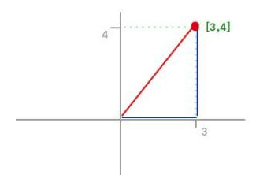
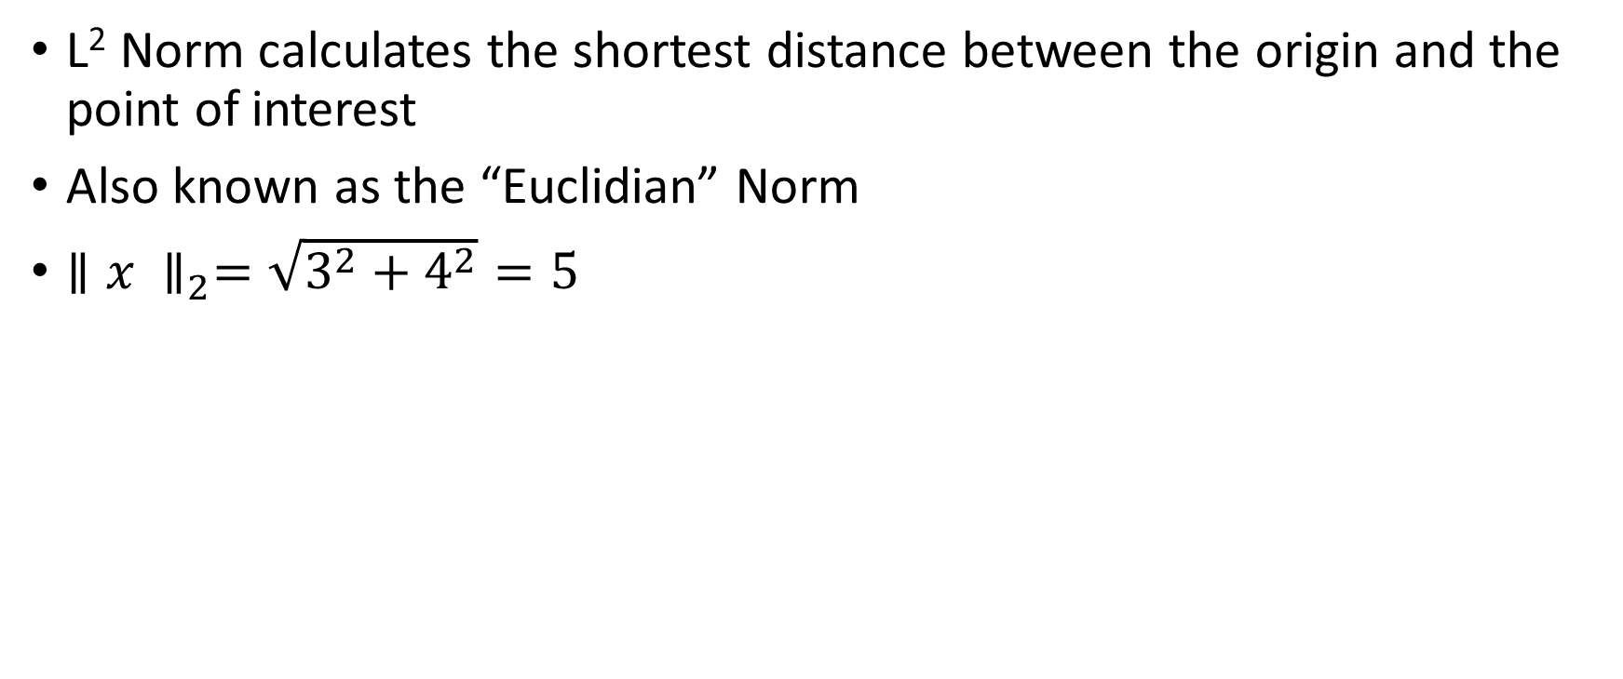
L2 Norm
L² Norm calculates the shortest distance between the origin and the point of interest
Also known as the “Euclidian” Norm
${∥x ∥}_{2}=\sqrt{3^{2}+4^{2}}=5$
5

Slide 40
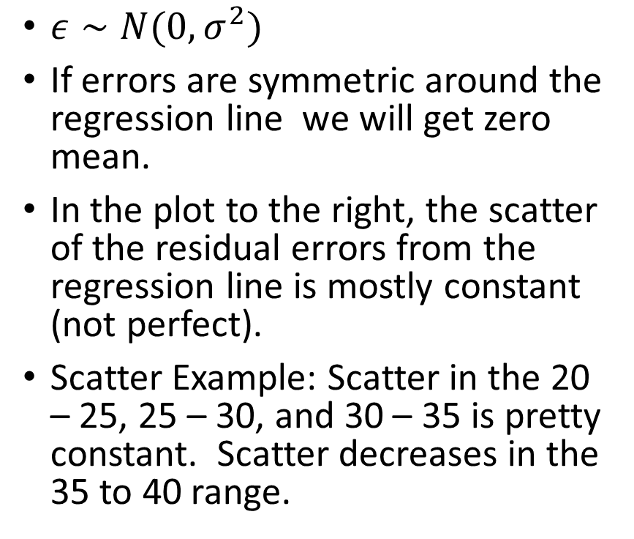
Zero Mean / Constant Variance Assumptions
$ε∼N(0,σ^{2})$
If errors are symmetric around the regression line we will get zero mean.
In the plot to the right, the scatter of the residual errors from the regression line is mostly constant (not perfect).
Scatter Example: Scatter in the 20 – 25, 25 – 30, and 30 – 35 is pretty constant. Scatter decreases in the 35 to 40 range.

Slide 41
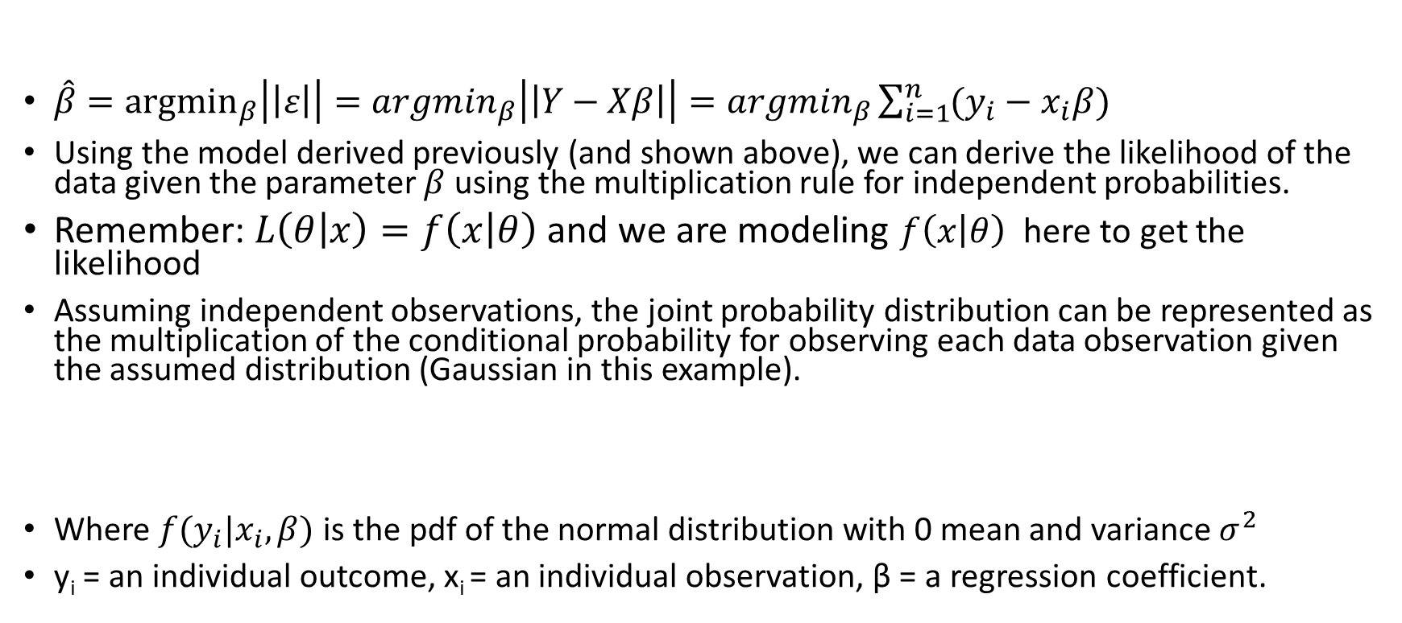
Derivation of Least Squares Using MLE
$\hat{β}={argmin}_{β}\left|\left|ε\right|\right|={argmin}_{β}\left|\left|Y−Xβ\right|\right|={argmin}_{β}\sum_{i=1}^{n}{(y_{i}−x_{i}β)}$
Using the model derived previously (and shown above), we can derive the likelihood of the data given the parameter $β$ using the multiplication rule for independent probabilities.
Remember: $L\left(θ | x\right)=f\left(x | θ\right)$ and we are modeling $f\left(x | θ\right)$ here to get the likelihood
Assuming independent observations, the joint probability distribution can be represented as the multiplication of the conditional probability for observing each data observation given the assumed distribution (Gaussian in this example).
Where $f(y_{i}|x_{i},β)$ is the pdf of the normal distribution with 0 mean and variance $σ^{2}$
y_{i} = an individual outcome, x_{i} = an individual observation, β = a regression coefficient.

Slide 42
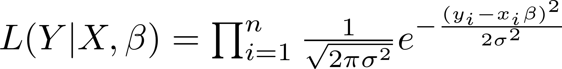
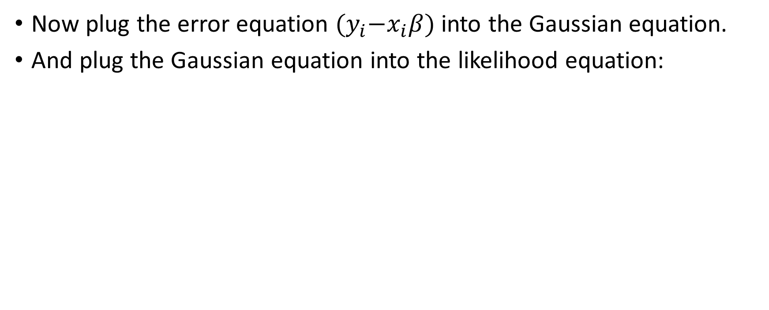
Derivation of Least Squares Using MLE
Now plug the error equation ${(y}_{i}−x_{i}β)$into the Gaussian equation.
And plug the Gaussian equation into the likelihood equation:

Slide 43
Derivation of Least Squares Using MLE
When dealing with likelihoods, it’s generally easier to take the log because products become sums and exponentials go away.
Applying the log transform to the equation on the previous slide (shown above) yields the equation below:

Slide 44
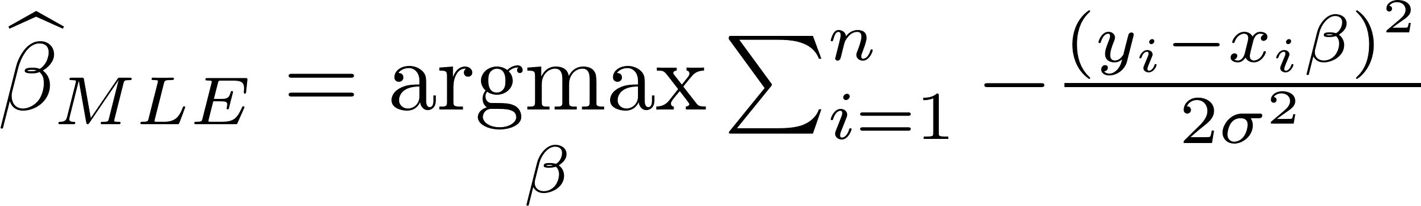
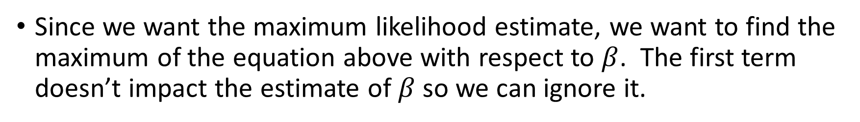
Derivation of Least Squares Using MLE
Since we want the maximum likelihood estimate, we want to find the maximum of the equation above with respect to $β$. The first term doesn’t impact the estimate of $β$ so we can ignore it.
$$\hat{β}MLE=Maximum of MLE with respect to β$$

Slide 45
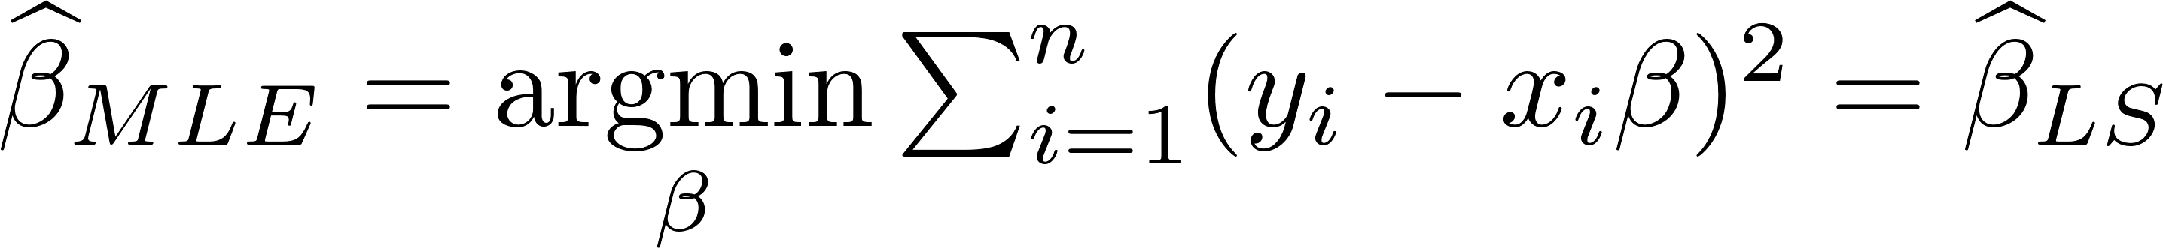
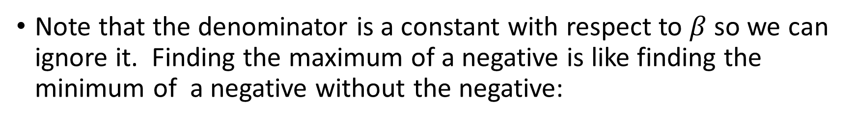
Derivation of Least Squares Using MLE
Note that the denominator is a constant with respect to $β$ so we can ignore it. Finding the maximum of a negative is like finding the minimum of a negative without the negative:

Slide 46
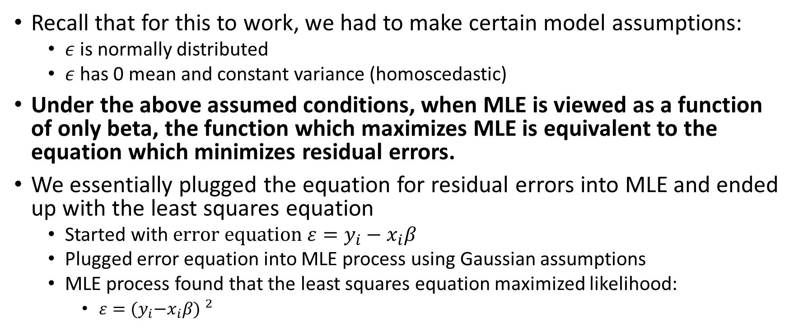
Derivation of Least Squares Using MLE
Recall that for this to work, we had to make certain model assumptions:
$ε$ is normally distributed
$ε$has 0 mean and constant variance (homoscedastic)
Under the above assumed conditions, when MLE is viewed as a function of only beta, the function which maximizes MLE is equivalent to the equation which minimizes residual errors.
We essentially plugged the equation for residual errors into MLE and ended up with the least squares equation
Started with $error equation ε=y_{i}−x_{i}β$
Plugged error equation into MLE process using Gaussian assumptions
MLE process found that the least squares equation maximized likelihood:
${ε={(y}_{i}−x_{i}β) }^{2}$

Slide 47
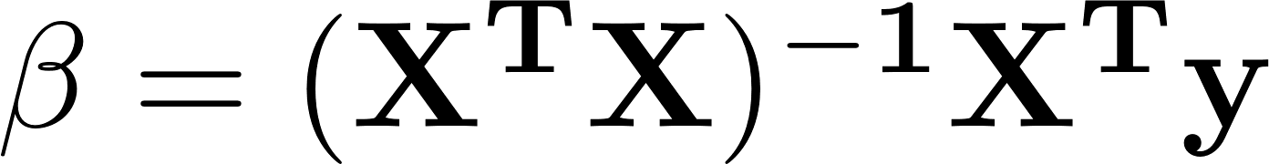
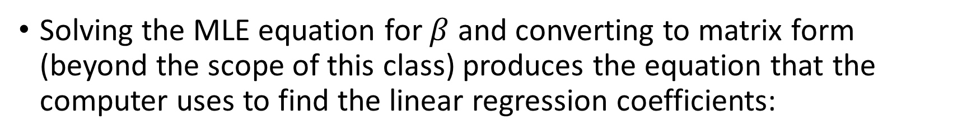
Derivation of Least Squares Using MLE
Solving the MLE equation for $β$ and converting to matrix form (beyond the scope of this class) produces the equation that the computer uses to find the linear regression coefficients:

Slide 48
Summary of MLE
MLE is used to find the probability distribution parameters that make the distribution best represent the data
If the distribution of the data is normal, we need to estimate the mean and standard deviation that makes the normal distribution best represent the data.
The math to estimate the best parameters can be quite messy but the results can be quite simple.
We typically do not do MLE calculations by hand; but rather, let the computer do the work for us.
MLE can be applied to any probability distribution.

Slide 49
Tying It All Together: Linear regression & Least Squares
Assume we have a data set which has a body mass index predictor(X) and a diabetes disease progression target (Y).
The goal is to find the line that is the best fit based on minimizing least squares.

Slide 50
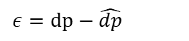
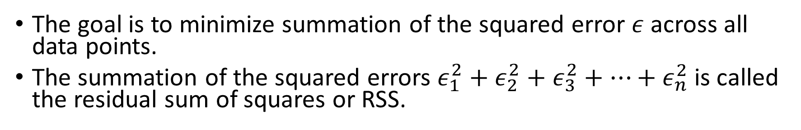
Tying It All Together: Linear regression & Least Squares
The goal is to minimize summation of the squared error $ε$ across all data points.
The summation of the squared errors $ε_{1}^{2}+ε_{2}^{2}+ε_{3}^{2}+…+ε_{n}^{2}$ is called the residual sum of squares or RSS.
Disease Progression vs. Body Mass Index
Real data point
Disease Progression
$$ε=dp−\hat{dp}$$
Prediction
bmi

Slide 51
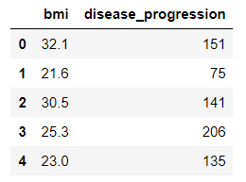
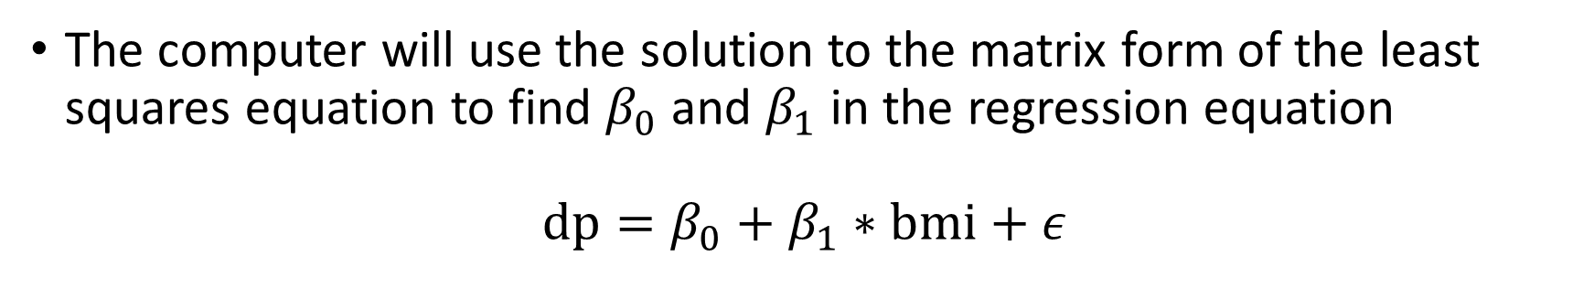
Tying It All Together: Linear regression & Least Squares
The computer will use the solution to the matrix form of the least squares equation to find $β_{0}$ and $β_{1}$ in the regression equation
$$dp=β_{0}+β_{1}∗bmi+ε$$

Slide 52
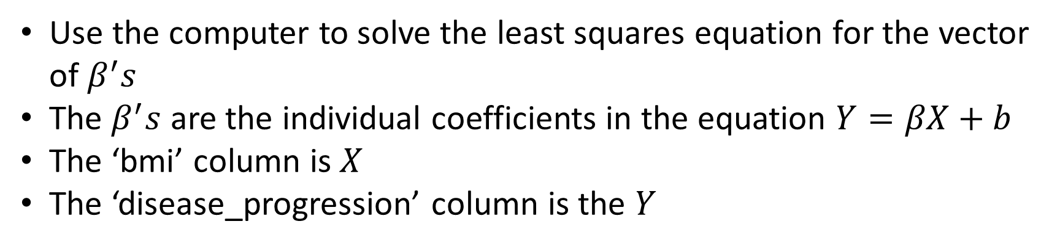
Tying It All Together: Linear regression & Least Squares
Use the computer to solve the least squares equation for the vector of $β^{′}s$
The $β^{′}s$ are the individual coefficients in the equation $Y=βX+b$
The ‘bmi’ column is $X$
The ‘disease_progression’ column is the $Y$

Slide 53
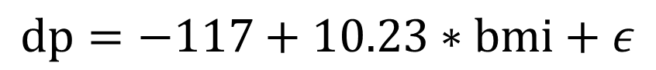
Tying It All Together: Linear regression & Least Squares
The resulting equation can be used to make predictions
Plug in a new ‘bmi’ to find a predicted disease progression
$$dp=−117+10.23∗bmi+ε$$

Slide 54
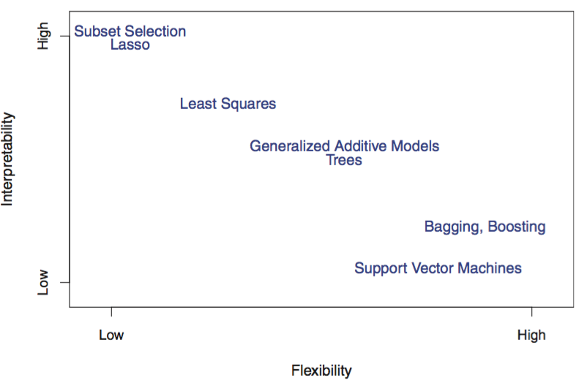
Flexibility (accuracy) vs. interpretability tradeoff
In general:
Simple models are less accurate but more interpretable
Complex models are more accurate but less interpretable
Model Interpretability vs. Flexibility

Slide 55
Regression vs classification
When the variable we are trying to predict (Y) is quantitative (like a real number), then we talk about regression
When the variable is categorical (like cat vs. dog), then we talk about classification
Can you guess supervised / unsupervised and regression/classification?
User behavior clustering
Sentiment analysis
Credit score
Predicting whether an image contains a cat or not.

Slide 56
Attendance
Please fill out the attendance sheet: https://docs.google.com/spreadsheets/d/1G5tiqXQn9mwyubWdINtPI_QONXH1_2U8oYikksgWlss/edit?usp=sharing
Write in a ‘1’ if you are present

